Slide 1
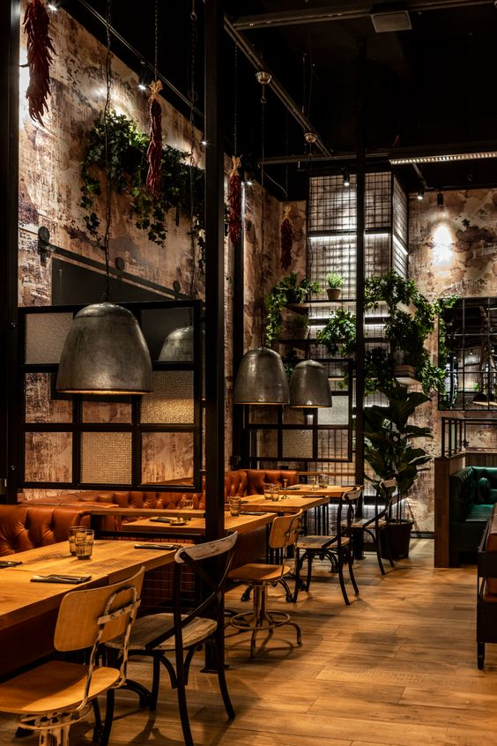
Grub Bites
Akshit Saxena (002673782)
Anuja Shinde (002747948)
Anuja Surana (002644394)
Vaidehi Tawde (002643847)
Vinit Yadav (002743210)

Slide 2
Introduction
Customers can place a variety of food orders straight from the website with the help of the online food ordering service Grub Bites. Customers can place orders utilizing a sleek and user-friendly interface thanks to the system's use of React. The system offers customers a variety of meal alternatives by supporting several cuisines, including Italian, Mexican, Chinese, and more.
Customers can also follow the progress of their orders and get real-time updates on their delivery status using the system. The admin interface enables the business owner to control their menu, establish prices, and keep track of order fulfillment for all the many food alternatives they offer.
Overall, Grub Bites is a handy and user-friendly meal ordering system that streamlines the ordering process for clients while giving the proprietor of the business a strong platform to run their business for all kinds of food selections.

Slide 3
Features
User Authentication
Common Payment Gateway Integration
Paying Amount with Stripe
Placing Orders
Store Orders in the Database
Retrieve Orders to User Profile
User Dashboard
Admin Dashboard
Manage Users, Products, Orders in Admin Panel
Add to Cart Feature
Update Quantity in Cart
Delete Products from the Cart

Slide 4




Tech Stack Used
React
mongoDB
Express.js
Node.js

Slide 5
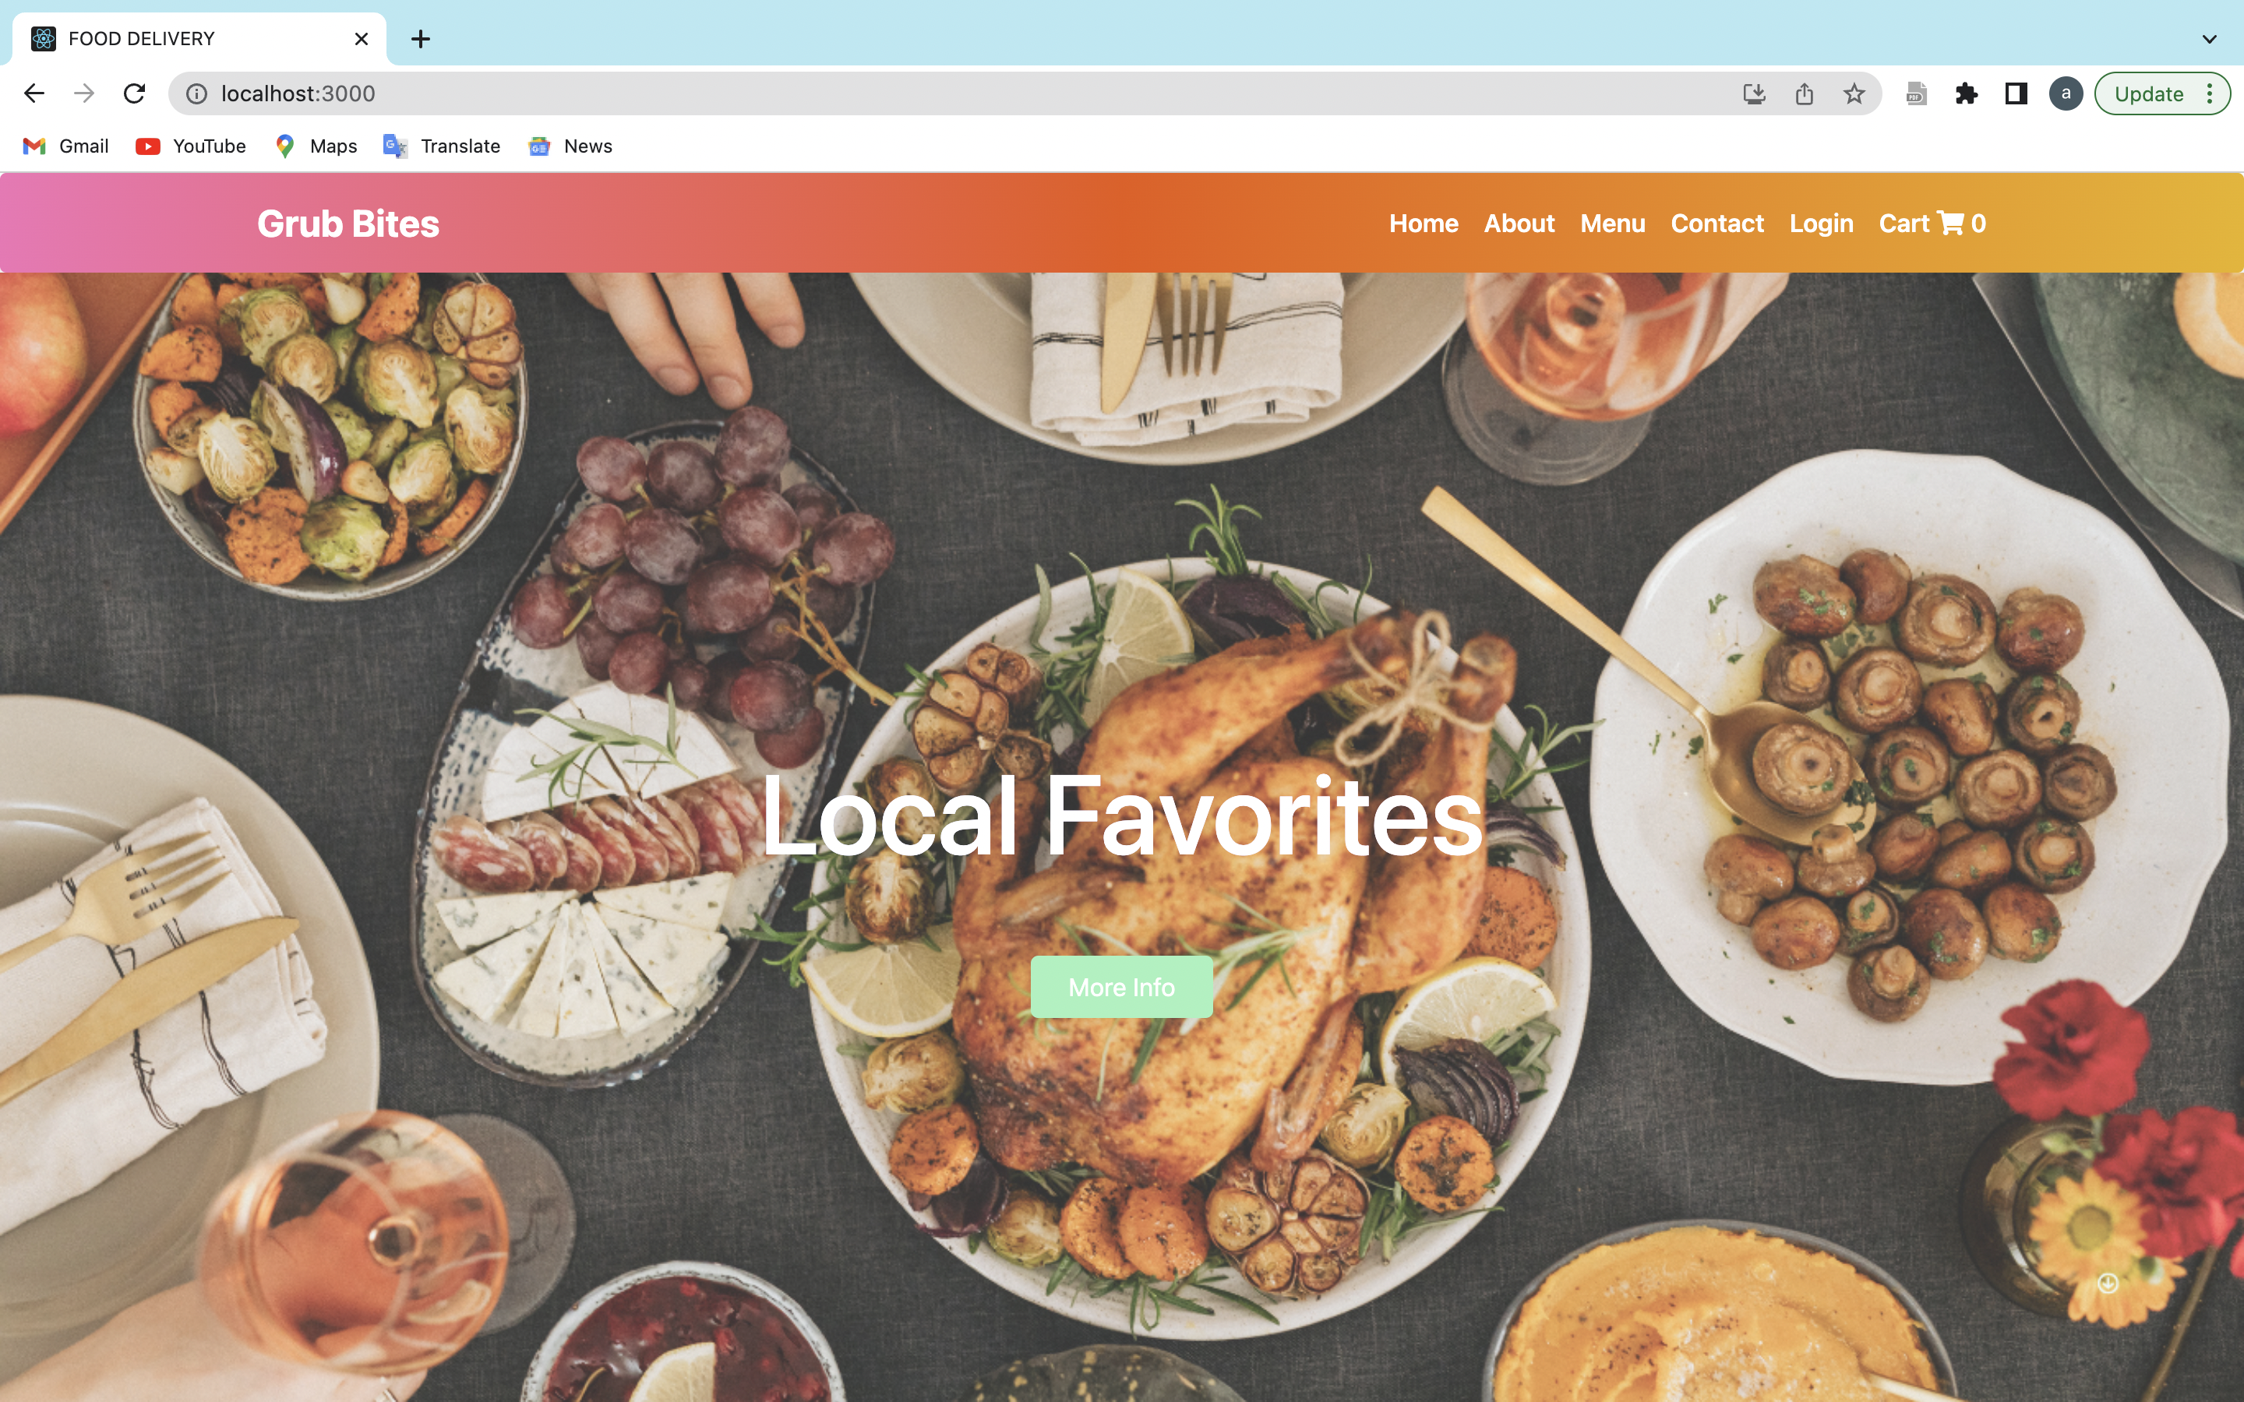
Output screenshots :

Slide 6
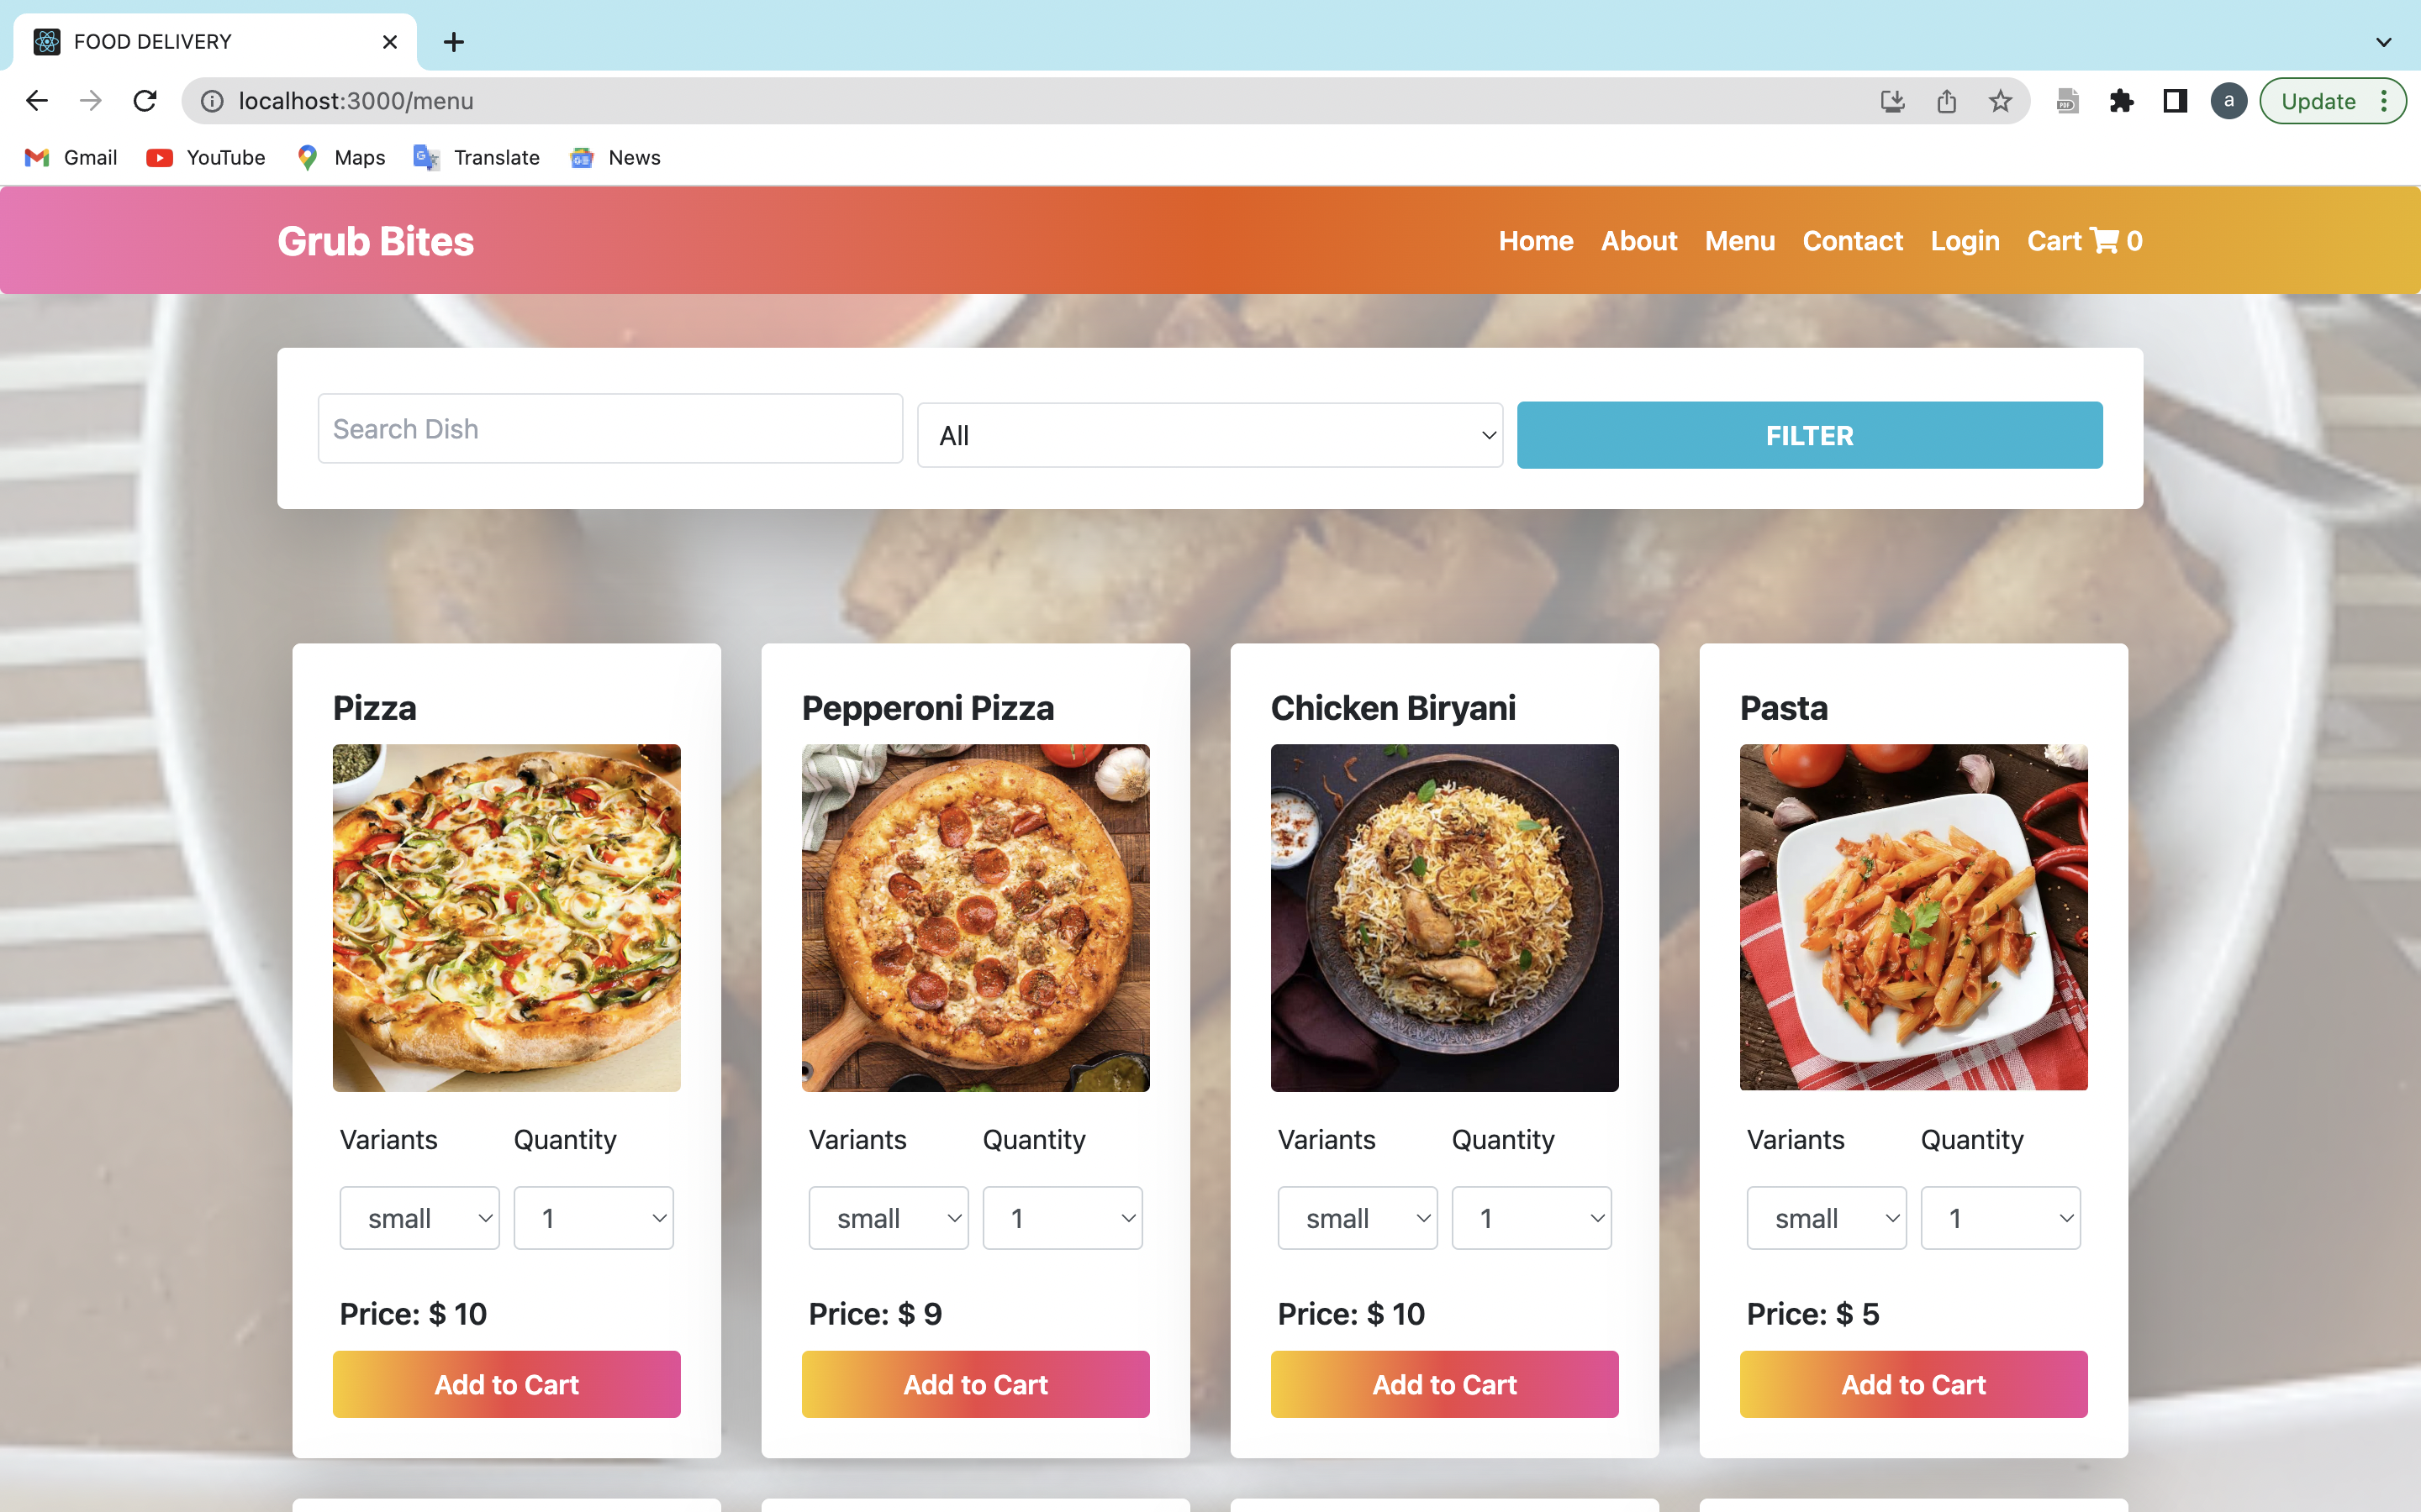

Slide 7
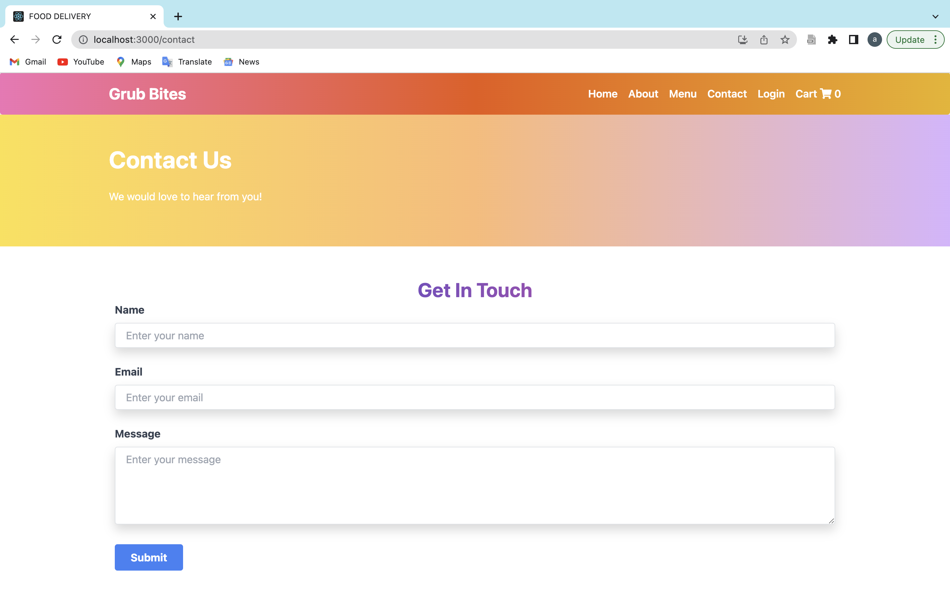

Slide 8
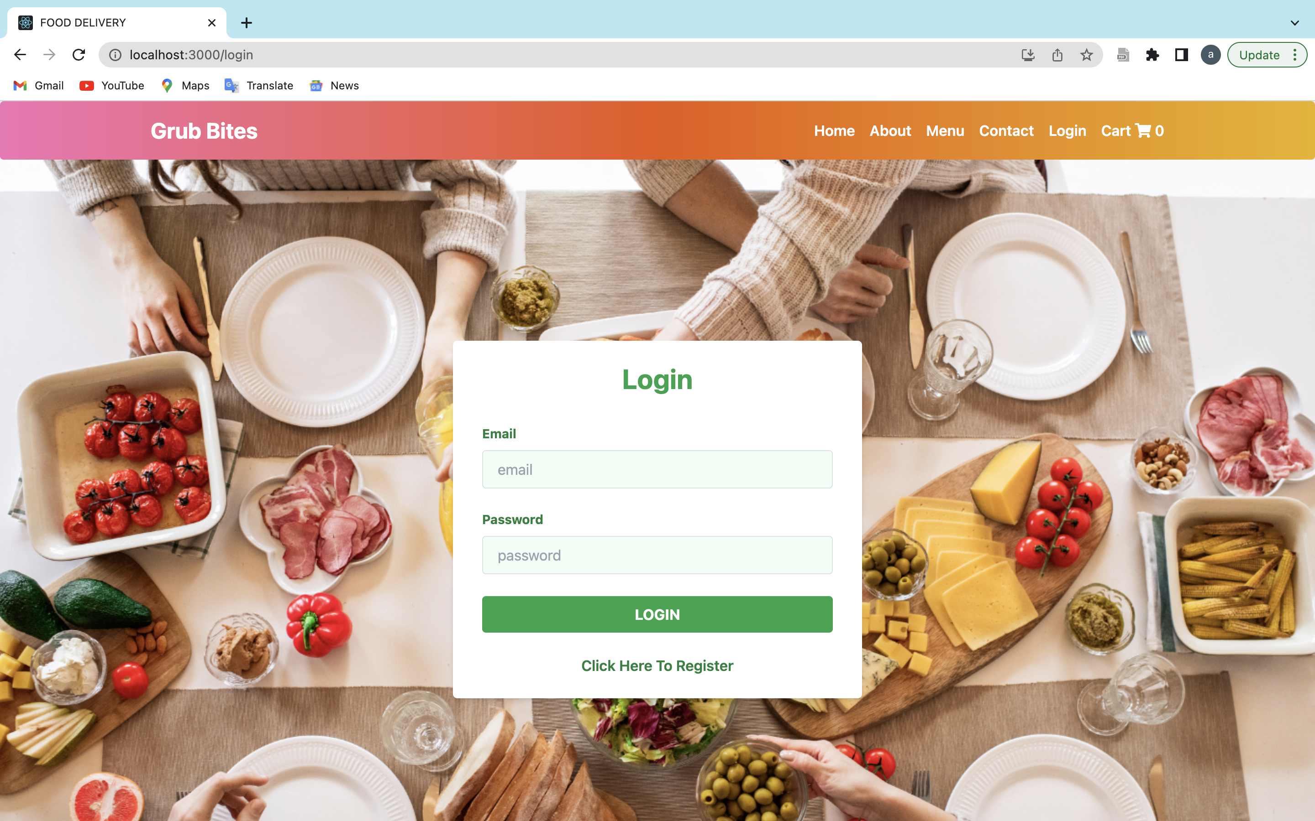

Slide 9
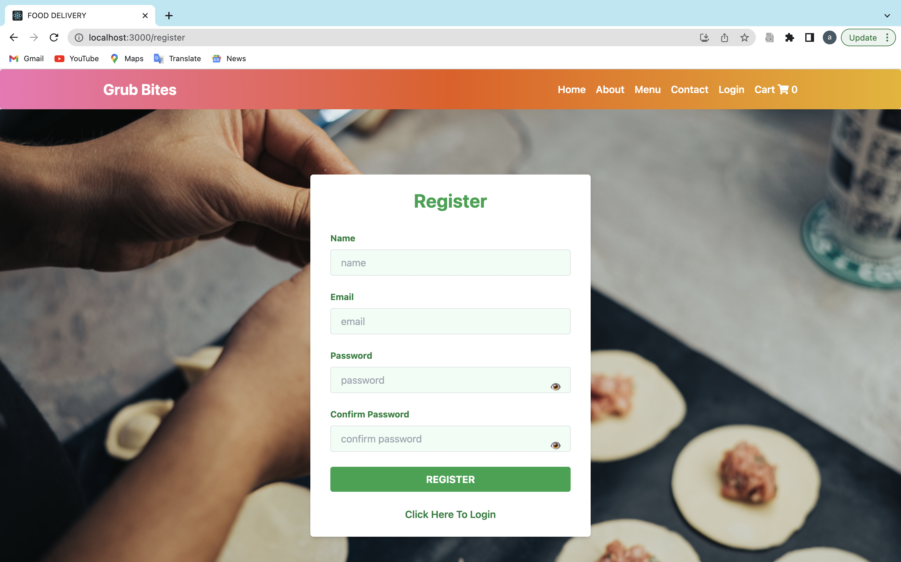

Slide 10
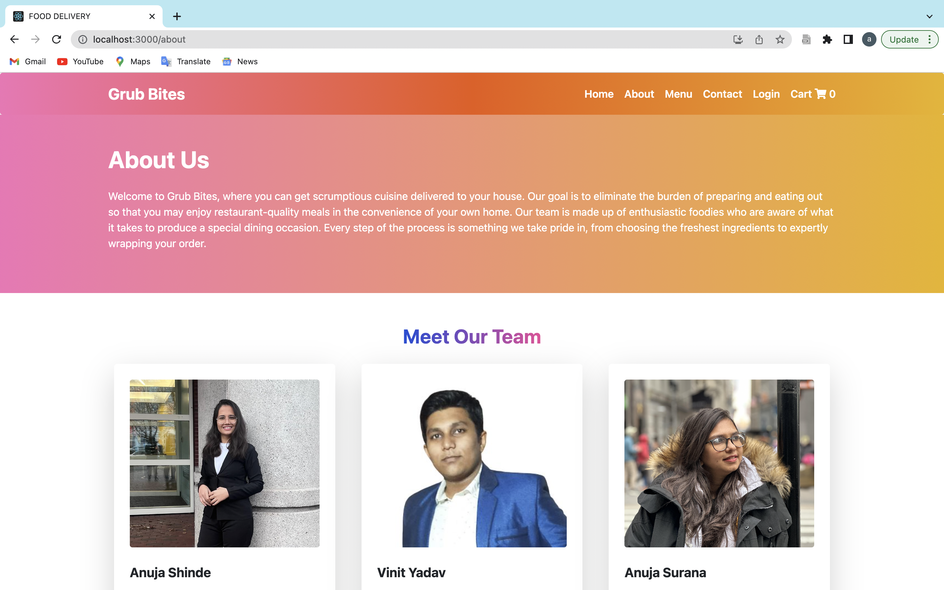

Slide 11
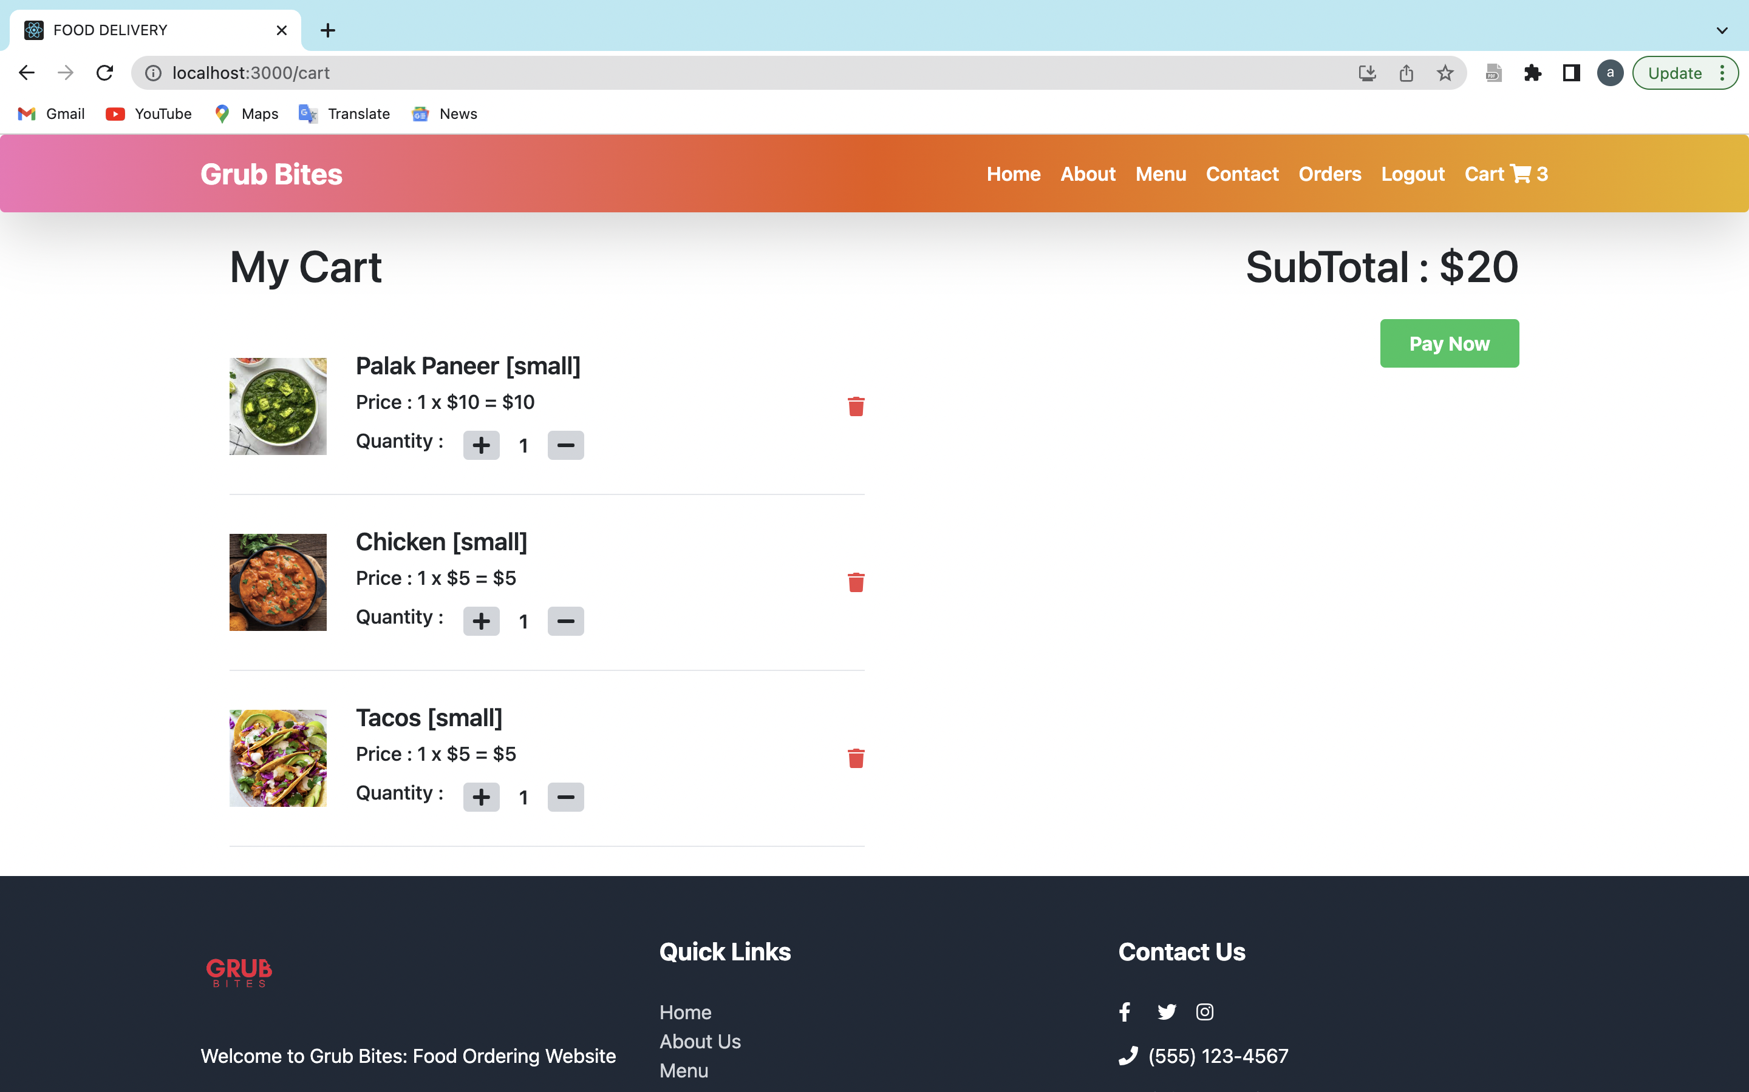

Slide 12
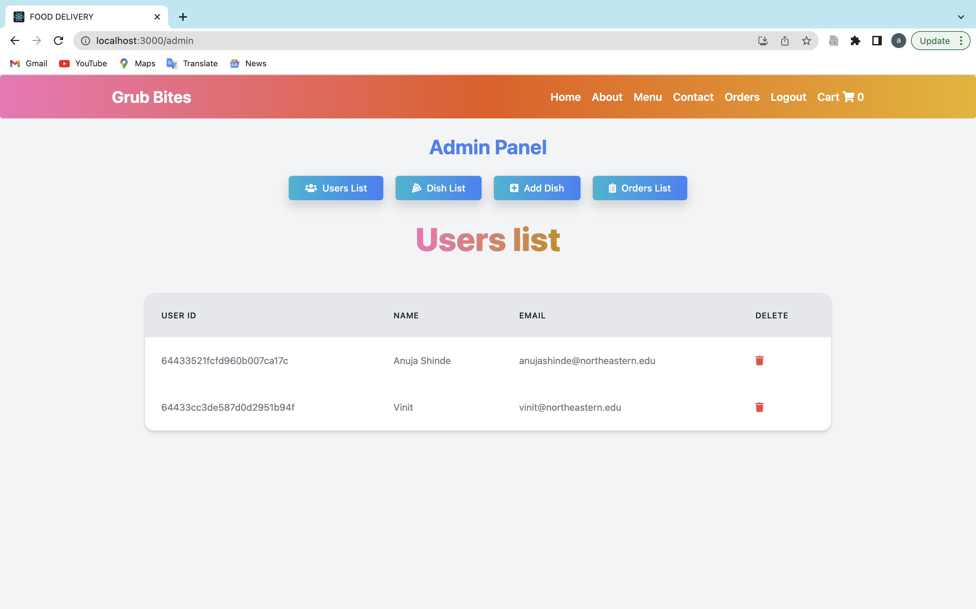

Slide 13
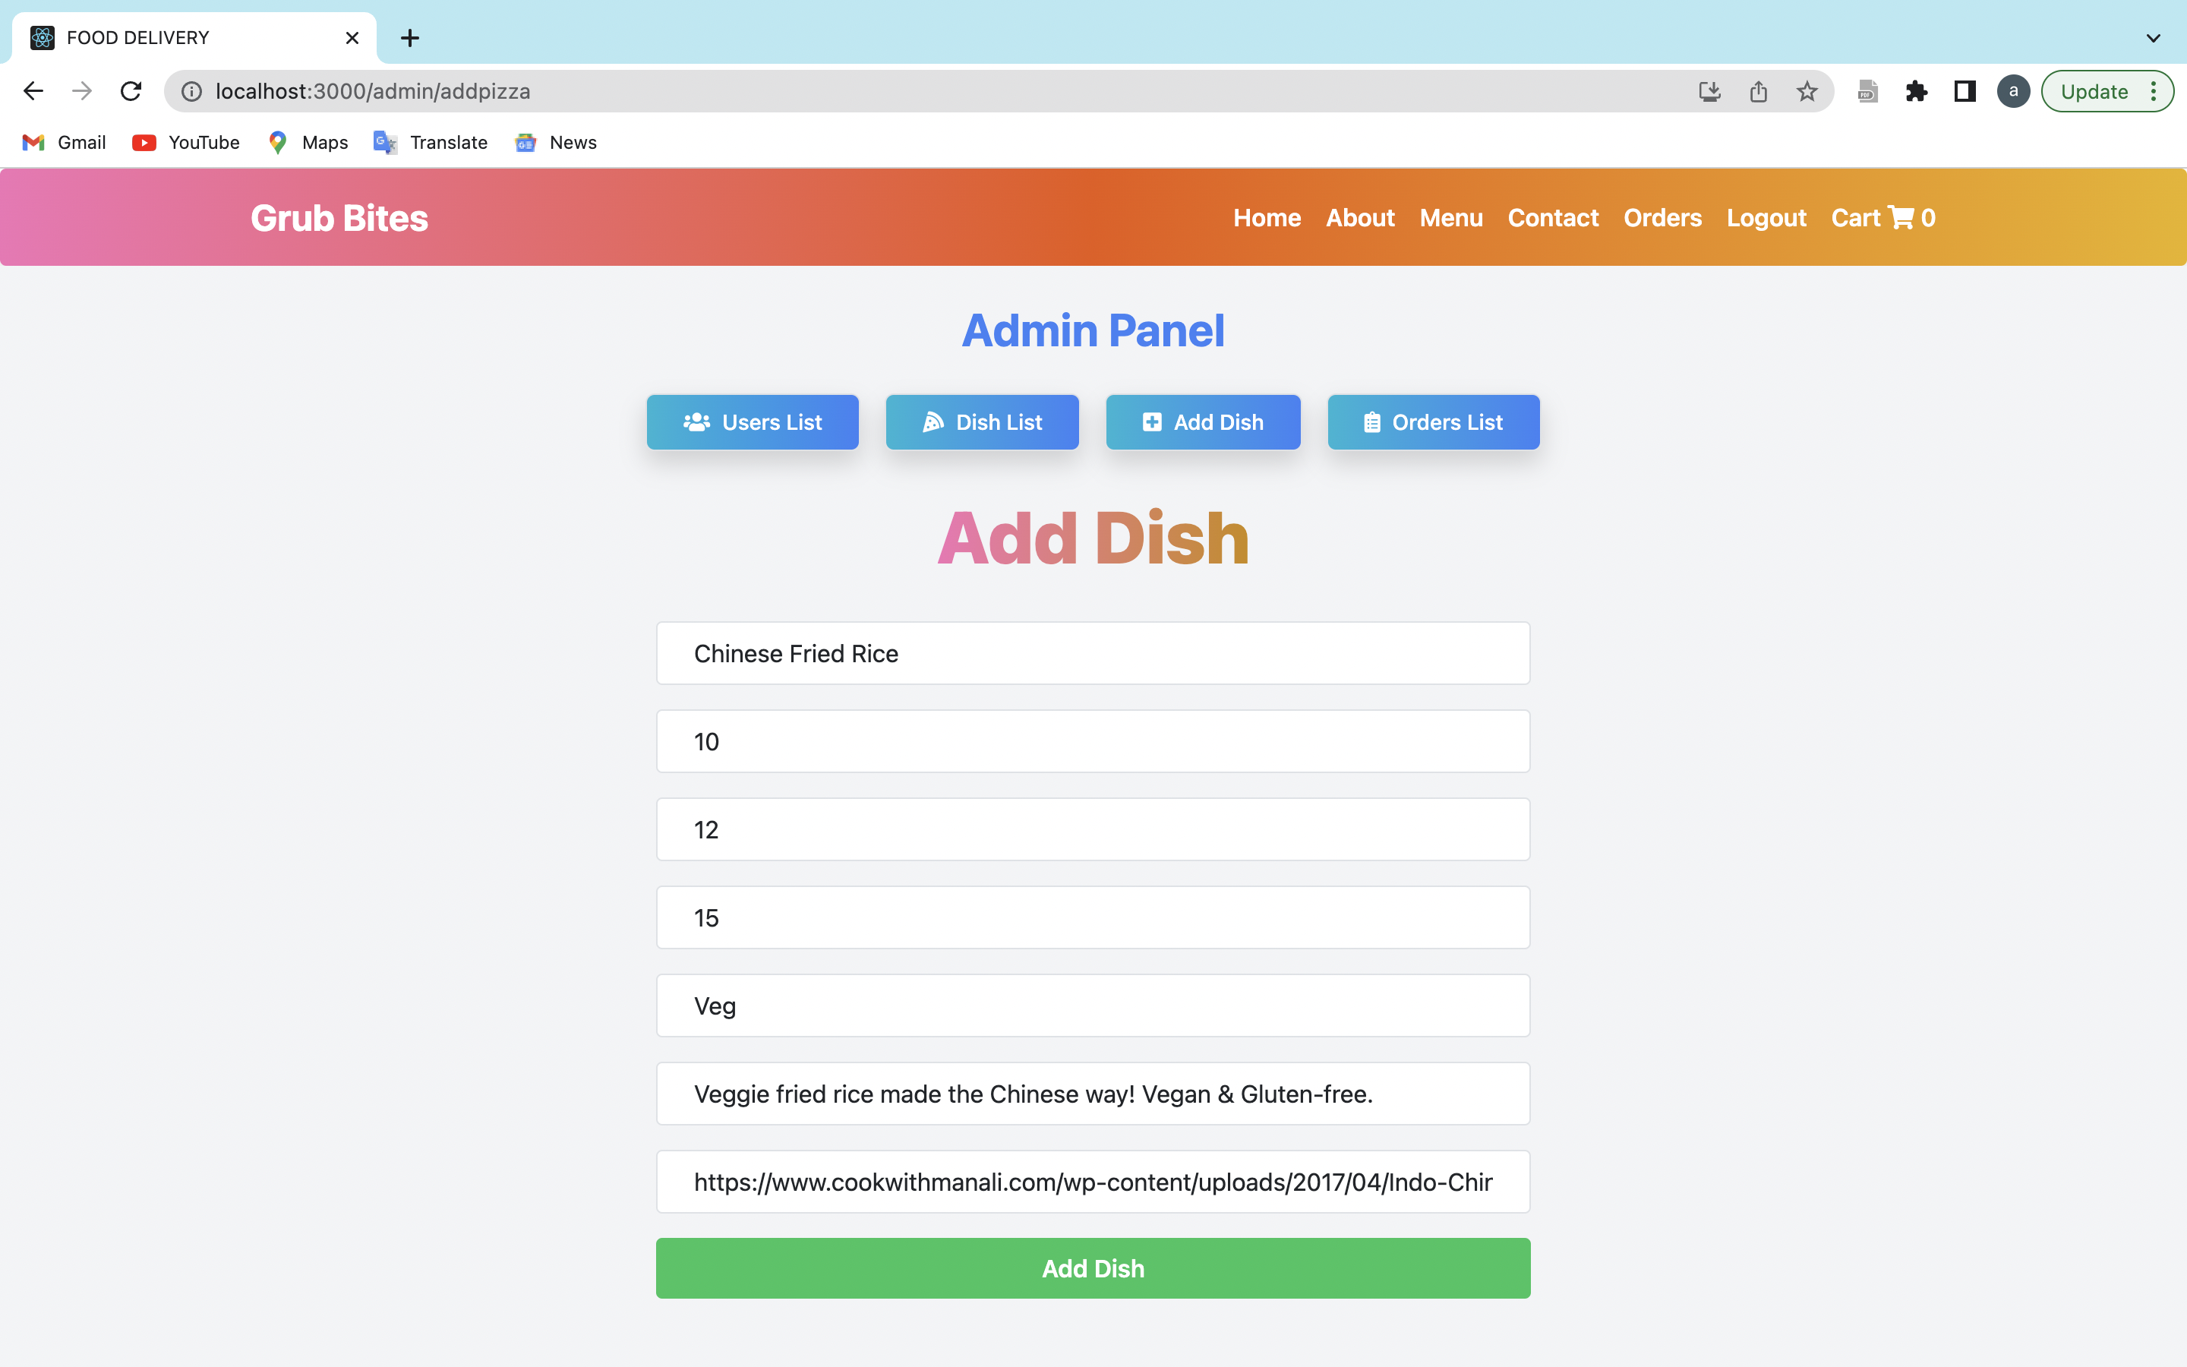

Slide 14
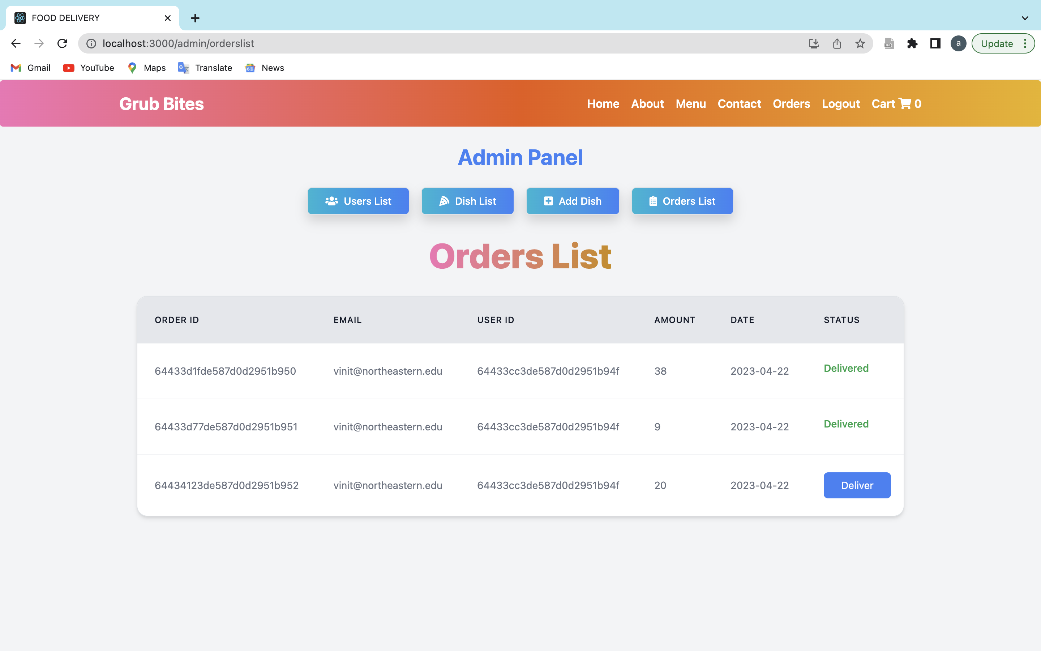

Slide 15
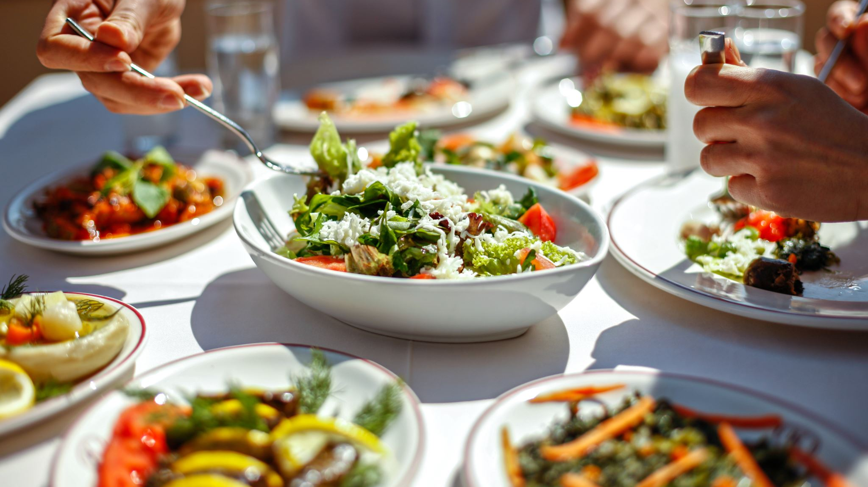
Thank You!

